Slide 1
Ensemble Learning
Sadia Islam Assistant Professor
Department of Computer Science and engineering United International University

Slide 2
Ensemble Classifier
It is the process of combining different classification techniques to build a powerful composite model from the data.
It returns a class label prediction for new instances based on the individual classifiers vote.
It improves the classification accuracy of class-imbalanced data.

Slide 3
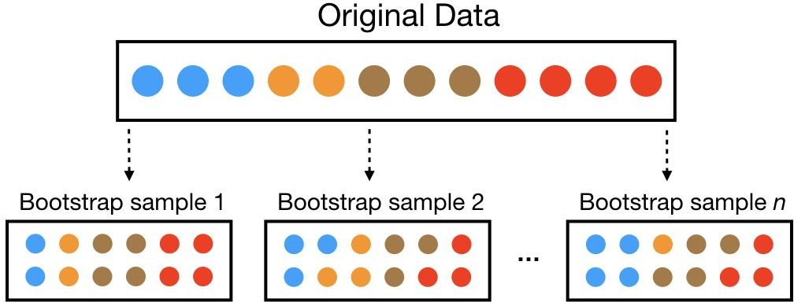
Bagging
Bagging, short for Bootstrap Aggregating, is an ensemble method designed to improve the accuracy and stability of machine learning models. It reduces variance and helps to avoid overfitting. Here is how Bagging works:
Bootstrap Sampling:
  From the original dataset, create multiple new datasets by random sampling with replacement. This means each new dataset (a bootstrap sample) will have same instances as the original dataset, but some instances may be repeated while others may be left out.

Slide 4
Bagging
Training Models:
  Train a separate model on each of these bootstrap samples. Typically, bagging is applied to high-variance models like decision trees.
Aggregating/combining Predictions:
  For classification problems, aggregate the predictions of each model by majority voting.
  For regression problems, aggregate the predictions by averaging.
Example: Random forest using Decision Trees

Slide 5
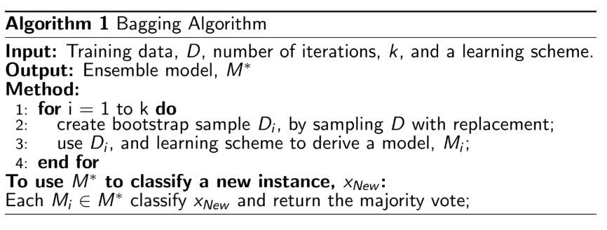
Bagging
●

Slide 6
Random Forest
How Random Forest Works
Bootstrapping: Random Forest starts by creating several subsets of the original dataset through bootstrapping. Bootstrapping is a technique where random samples are drawn with replacement.
Feature Selection: At each node in the decision tree, Random Forest selects a random subset of features. This helps in making the trees less correlated.
Building Trees: Each bootstrapped subset is used to build a decision tree. Since each tree is trained on a slightly different dataset and feature set, the trees are diverse.
Combining Predictions:
  For classification, the final prediction is made by taking a majority vote of predictions from all the decision trees.
  For regression, the final prediction is made by averaging the predictions of all the decision trees.

Slide 7
Random Forest - example
Imagine you have a dataset with 100 samples and 5 features (A, B, C, D, E). Let's see how a Random Forest would be created:
Create Bootstrapped Datasets
  Generate, say, 10 bootstrapped datasets from the original 100 samples. Each dataset will have 100 samples drawn with replacement.
Build Decision Trees:
  For each bootstrapped dataset, build a decision tree. At each split in the tree, only consider a random subset of, say, 3 out of the 5 features.
Combine Predictions:
  If predicting whether to play tennis, each tree gives a vote (Yes or No). The final prediction is the majority vote among the 10 trees.

Slide 8
Boosting
Boosting is another powerful ensemble technique that aims to improve the accuracy of machine learning models by combining the predictions of several weak learners to create a strong learner. Unlike bagging, which builds models independently, boosting builds models sequentially, with each model correcting the errors of its predecessor.

Slide 9
Boosting
How Boosting Works
Initialize Weights:
  Start by assigning equal weights to all instances in the training dataset.
Train Weak Learner:
  Train a weak learner (e.g., a decision tree with limited depth) on the weighted dataset.
Calculate Error:
  Evaluate the performance of the weak learner on the training dataset. Calculate the error and the performance metric of the learner.
Update Weights:
  Increase the weights of the misclassified instances so that the next learner focuses more on these hard-to-classify cases.
Train Next Weak Learner:
  Train the next weak learner on the updated weights dataset.
Combine Weak Learners:
  Combine the weak learners using a weighted sum, where the weight of each learner is based on its performance. The final prediction is made based on this combined model.

Slide 10
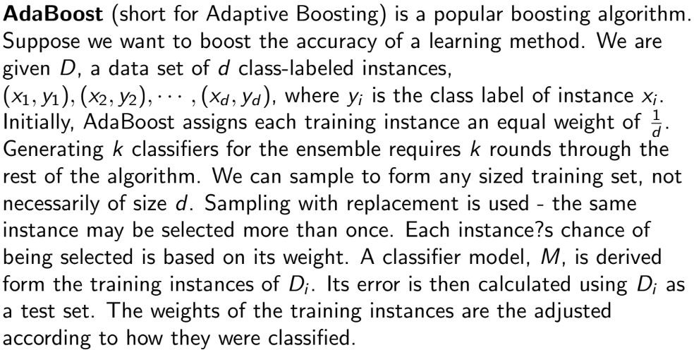
Adaboost

Slide 11
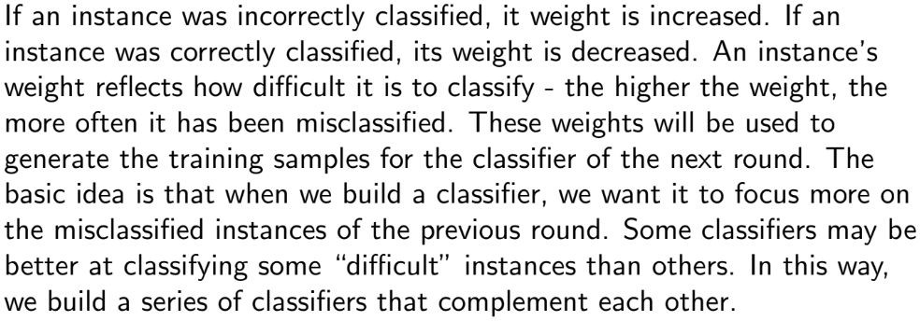
Adaboost

Slide 12
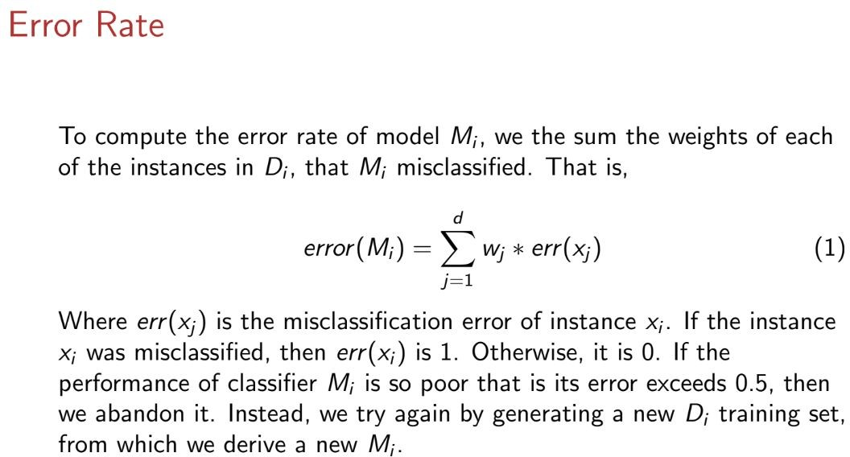
Adaboost

Slide 13
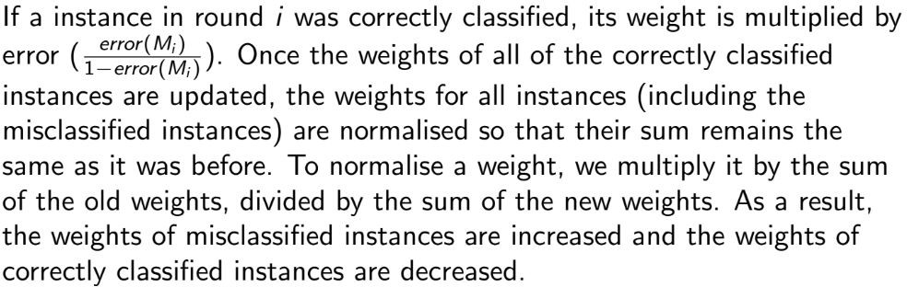
Adaboost
Normalising weight:

Slide 14
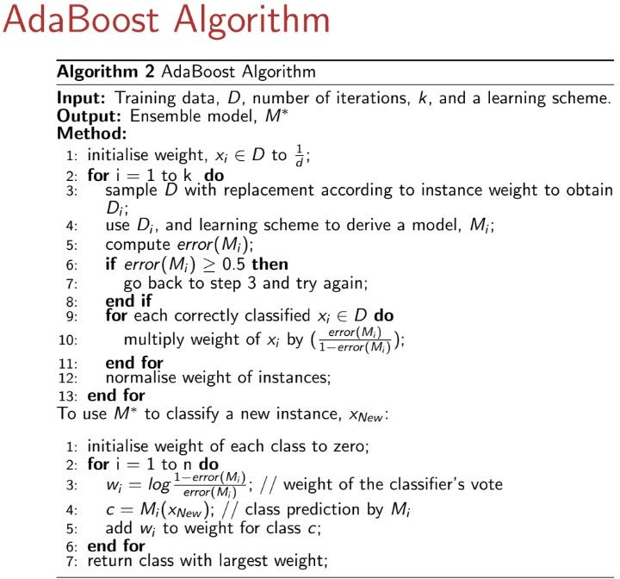

Slide 15
TY

